Slide 1
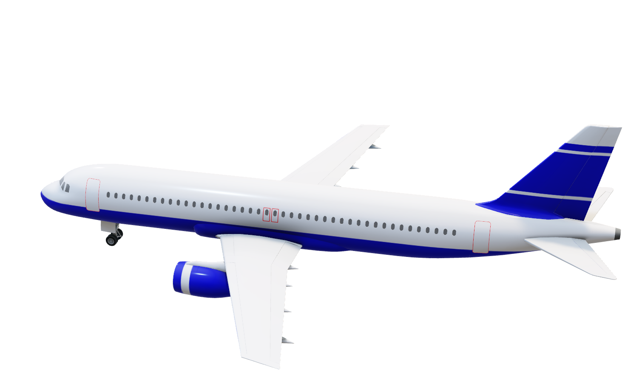
Mini Project On
Airline Reservation System

Slide 2
Project By :
Mahesh Badhe
( A - 03)
Aditya Deo
( A - 15)
Darshan Ganatra
( A - 21)
Akshay Karale
( A - 30)
Guided by
--Prof. Ajit Pagar

Slide 3
Contents :
Abstract
Objective
Scope
Introduction
Requirement's
Advantages
Conclusion
References

Slide 4
Abstract :
Our project is an attempt to stimulate the basic concepts of real world airline reservation system.
The main Purpose of this software is to reduce the manual errors involved in the airline reservation process and make it convenient for the customers to book the flights as when they require.
The Airline Reservation System project mainly consists of two types of users. The customers who access the information provided by the website and the administrator who modifies and updates the information.
The system enables the customer to do the things such as search for airline flights ( Domestic & International ) for two travel cities on a specified date, choose a flight based on the details, reservation of flight and cancellation of reservation.

Slide 5
Objective :
To create a distributed system that will be used by customers.
To ensure that ticket reservation is easy and user friendly for customers.
To satisfy customers need by reaching them at their place.
Reduce the work load of the ticket officers.
Provide large number of ticket reservation and cancelation service in a few time.

Slide 6
Scope :
This project designs and implements air ticket reservation system.
Supported by a well-designed database, all available air flight information is integrated together and can be accessed easily through a single point.
A friendly user interface is provided so that various combinations of search criteria can be fetched from user and generates corresponding database search statements.
The air ticket reservation system provided both customer and administration interfaces with the latter used for administration purposes.

Slide 7
Introduction :
The Airline Reservation System project is an implementation of a general Airline Ticketing application, which helps the customers to search the availability of various airline tickets.
This project also covers various features like registration of the users, modifying the details of the application by the administrator , by adding, deleting or modifying the customer details, flights information.
This system will be implemented using Java & SQL will act as a database
It will enhance the relationship between customers and airline agencies

Slide 8
Requirement’s :
Software Requirements |  | Hardware Requirements
Operating System : | Windows or Linux or MAC | Processor : | 800MHz Intel Pentium III or greater
User Interface : | NetBeans | Hard Disk : | 10 GB minimum
Programming Language : | JAVA | RAM : | 512MB or more
Database : | MYSQL
Server used : | XAMPP

Slide 9
Technologies to be used :
JavaFX
JavaFX is a Java library used to develop Desktop applications as well as Rich Internet Applications (RIA). The applications built in JavaFX, can run on multiple platforms including Web, Mobile and Desktops.
JavaFX is intended to replace swing in Java applications as a GUI framework. Like Swing, JavaFX also provides its own components and doesn't depend upon the operating system. It is lightweight and hardware accelerated. It supports various operating systems including Windows, Linux and Mac OS.
MySQL
MySQL is a fast, easy to use relational database. It is currently the most popular open-source database. It is very commonly used in conjunction with PHP scripts to create powerful and dynamic server-side applications.
MySQL is used for many small and big businesses. It is developed, marketed and supported by MySQL AB, a Swedish company. It is written in C and C++.

Slide 10
Technologies to be used (Contd.):
XAMPP
XAMPP is a small and light Apache distribution containing the most common web development technologies in a single package. Its contents, small size, and portability make it the ideal tool for students developing and testing applications in PHP and MySQL. XAMPP is available as a free download in two specific packages: full and lite.
JDBC
Java Database Connectivity (JDBC) is an application programming interface (API) for the programming language Java, which defines how a client may access a database. It is a Java-based data access technology used for Java database connectivity. It is part of the Java Standard Edition platform, from Oracle Corporation.

Slide 11
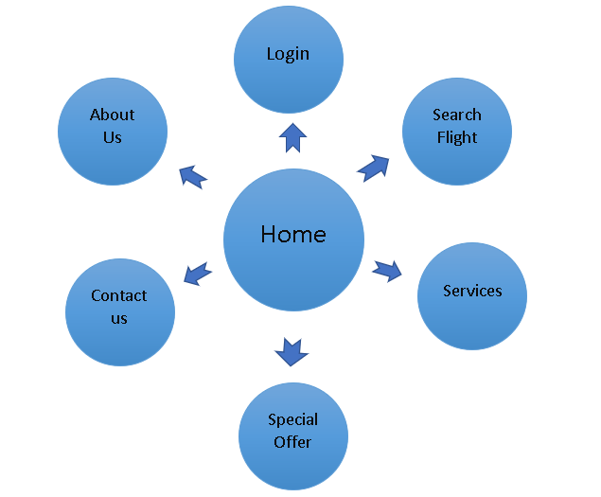
Home page Functionality :

Slide 12
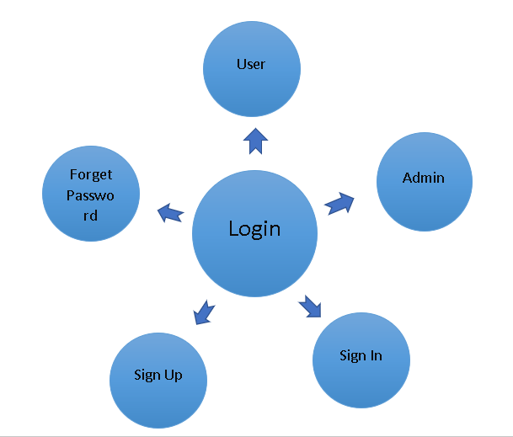
Login Functionality :

Slide 13
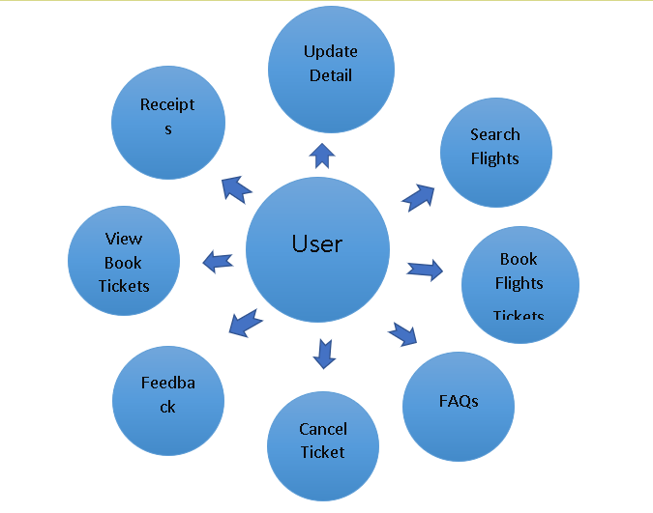
End-User Functionality :

Slide 14
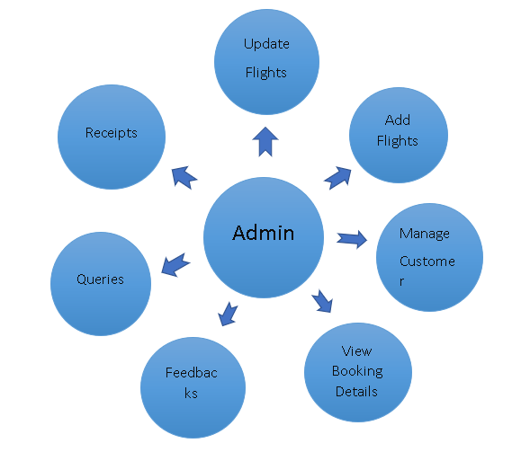
Admin Functionality :

Slide 15
Database Schema :
admin :
Column Name | Data Type | Constraints | Description
id | int(11) | auto_increment, Not Null | User id
username | varchar(50) | Not Null | Username of admin
password | varchar(50) | Not Null | Password of resp. username

Slide 16
Database Schema (Contd.):
admindetail :
Column Name | Data Type | Constraints | Description
id | int(11) | auto_increment, Not Null | User id
firstname | varchar(50) | Not Null | First name of user
lastname | varchar(50) | Not Null | last name of user
email | varchar(50) | Not Null | Email address
mobileno | bigint(30) | Not Null | Mobile no of user
gender | varchar(20) | Not Null | Male/female/other
dob | date | Not Null | Date of birth of person

Slide 17
Database Schema (Contd.):
contactus :
Column Name | Data Type | Constraints | Description
Fname | varchar(20) | Not Null | First name
Lname | varchar(20) | Not Null | Last Name
Email | varchar(30) | Not Null | Email id
Query | varchar(200) | Not Null | For Message

Slide 18
Database Schema (Contd.):
customer :
Column Name | Data Type | Constraints | Description
id | int(11) | auto_increment, Not Null | User id of customer
username | varchar(50) | Not Null | Username of customer
password | varchar(50) | Not Null | Password of resp. username

Slide 19
Database Schema (Contd.):
customerdetail :
Column Name | Data Type | Constraints | Description
id | int(11) | auto_increment, Not Null | User id
firstname | varchar(50) | Not Null | First name of user
lastname | varchar(50) | Not Null | last name of user
email | varchar(50) | Not Null | Email address
mobileno | bigint(30) | Not Null | Mobile no of user
gender | varchar(20) | Not Null | Male/female/other
dob | date | Not Null | Date of birth of person

Slide 20
Database Schema (Contd.):
feedback :
Column Name | Data Type | Constraints | Description
userid | Varchar(30) | Not Null | User id
ques1 | varchar(15) | Not Null | Question 1 Answer
ques2 | varchar(15) | Not Null | Question 2 Answer
ques3 | varchar(15) | Not Null | Question 3 Answer
ques4 | varchar(15) | Not Null | Question 4 Answer
ques5 | varchar(15) | Not Null | Question 5 Answer

Slide 21
Database Schema (Contd.):
fligtdetail :
Column Name | Data Type | Constraints | Description
flightid | int(11) | auto_increment, Not Null | Flight Id
nameflight | varchar(50) | Not Null | Flight Name
source | varchar(50) | Not Null | Source Name
destination | varchar(50) | Not Null | Destination Name
takeuptime | Time | Not Null | Departure Time
landongtime | Time | Not null | Arrival Time
type | Varchar(50) | Not null | Class of the flight
charges | Int(60) | Not Null | Price of Each Ticket

Slide 22
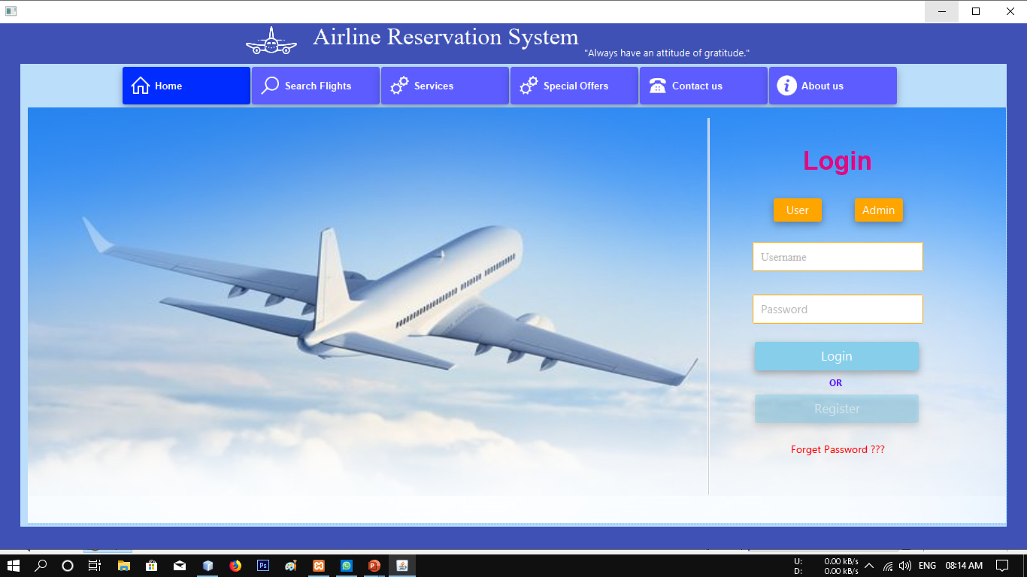
Design :

Slide 23
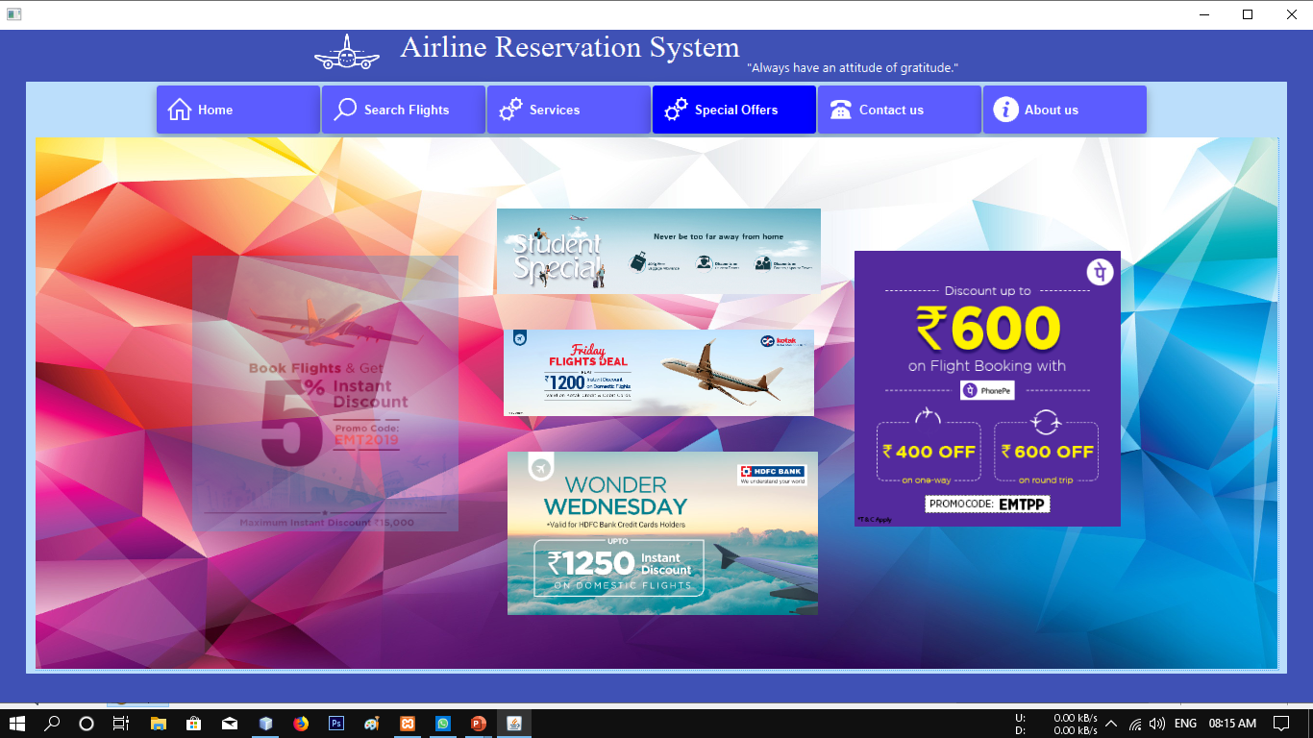
To Attract Passengers We are giving them a special Offers’

Slide 24
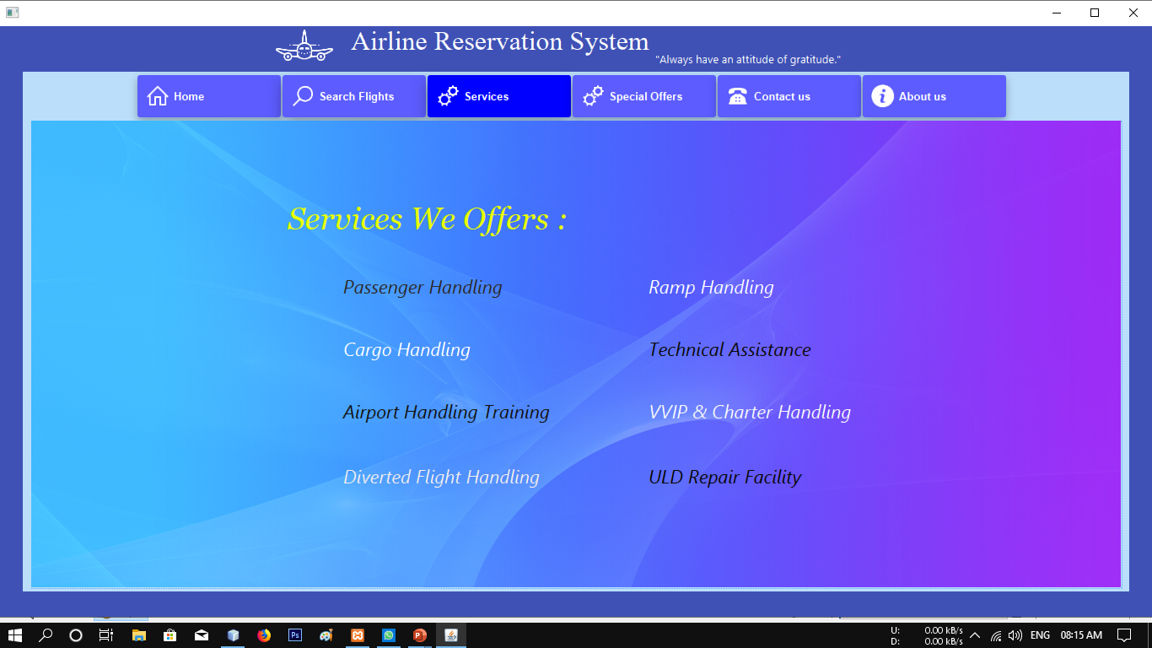
Good Services is the of Project

Slide 25
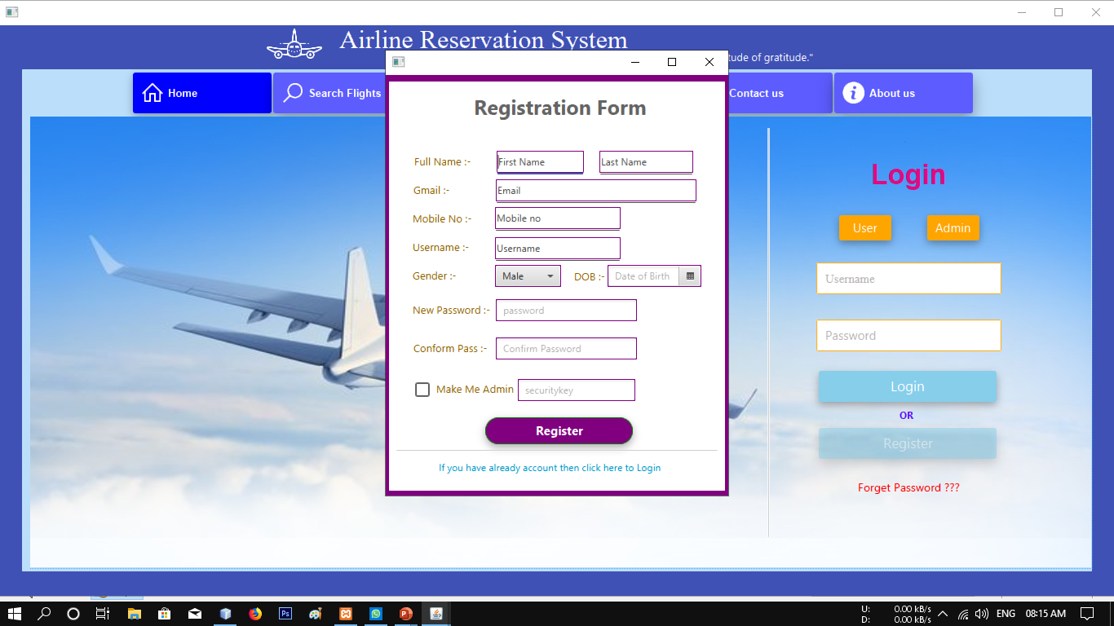
Registration Form for both Customer and Admin

Slide 26
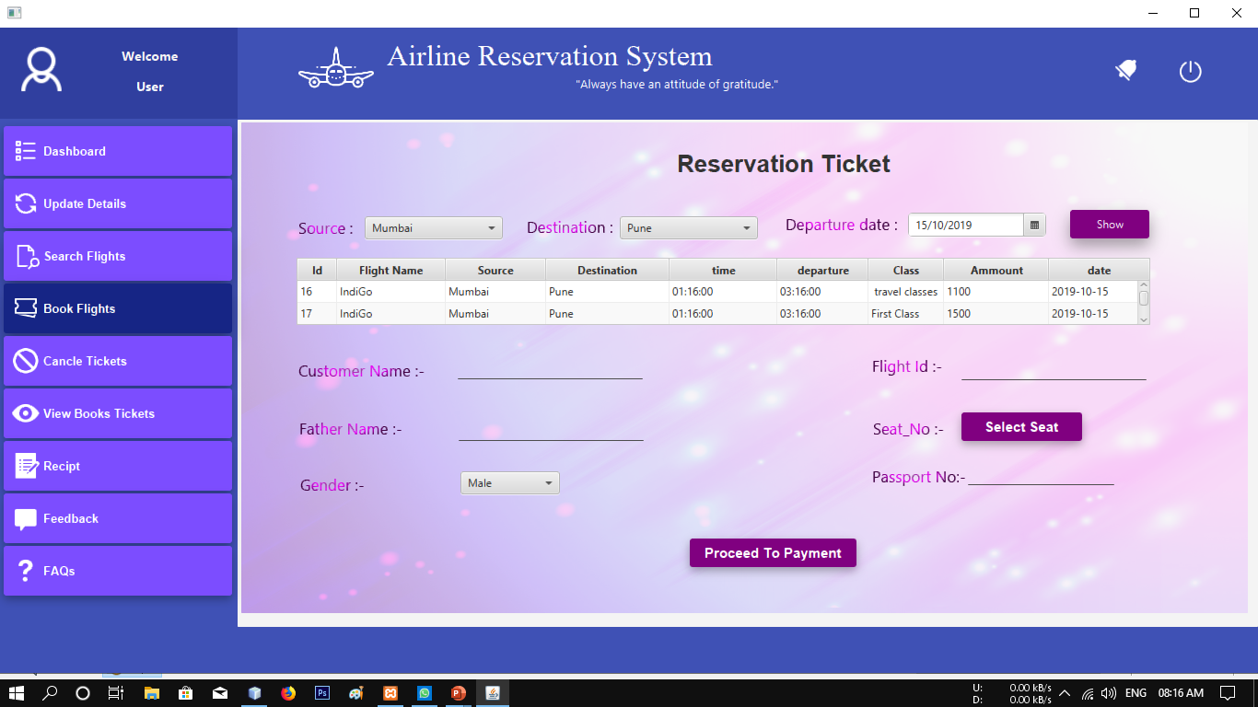
User Friendly UI for Ticket Booking

Slide 27
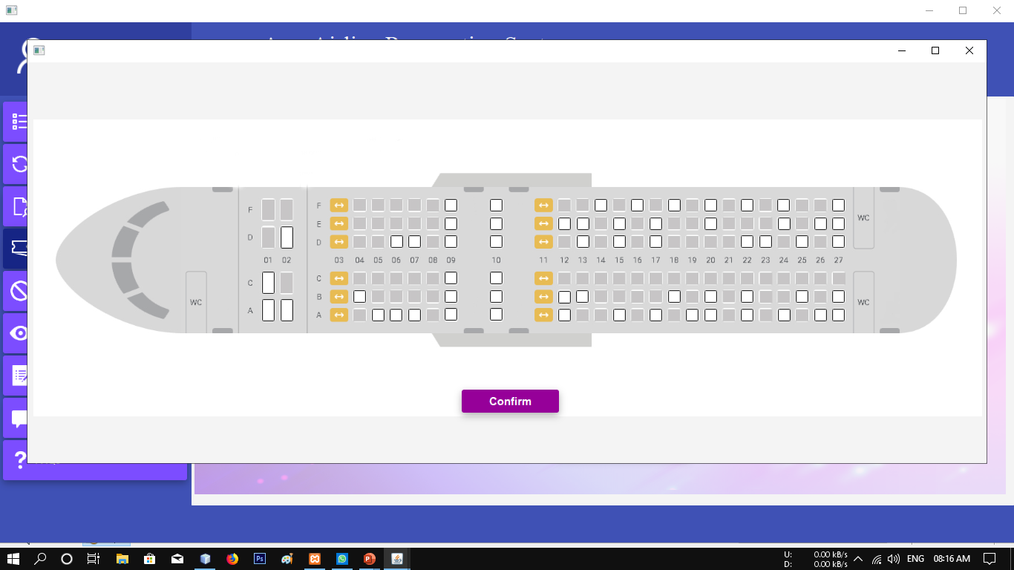
Freedom to choose your seat

Slide 28
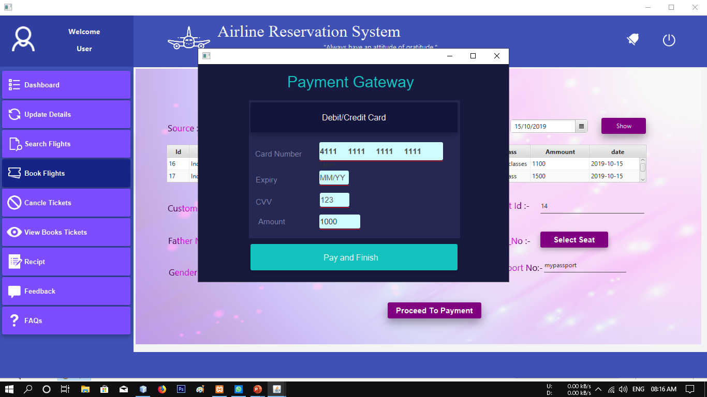
Secured Payment Gateway

Slide 29
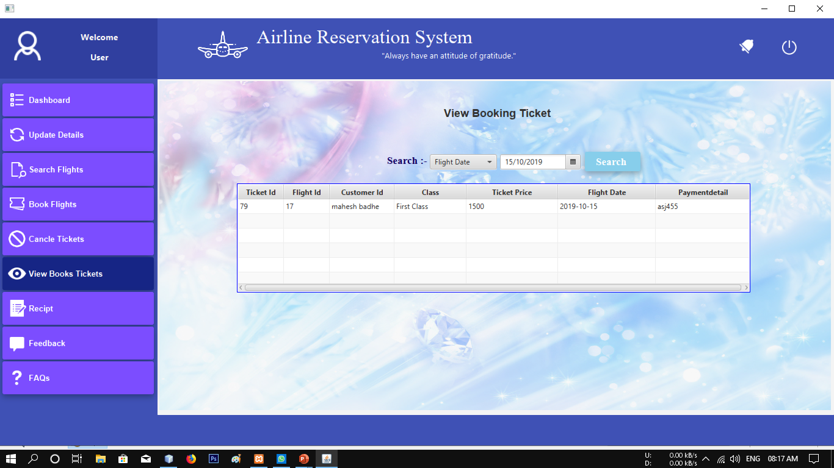
Find your Booking

Slide 30
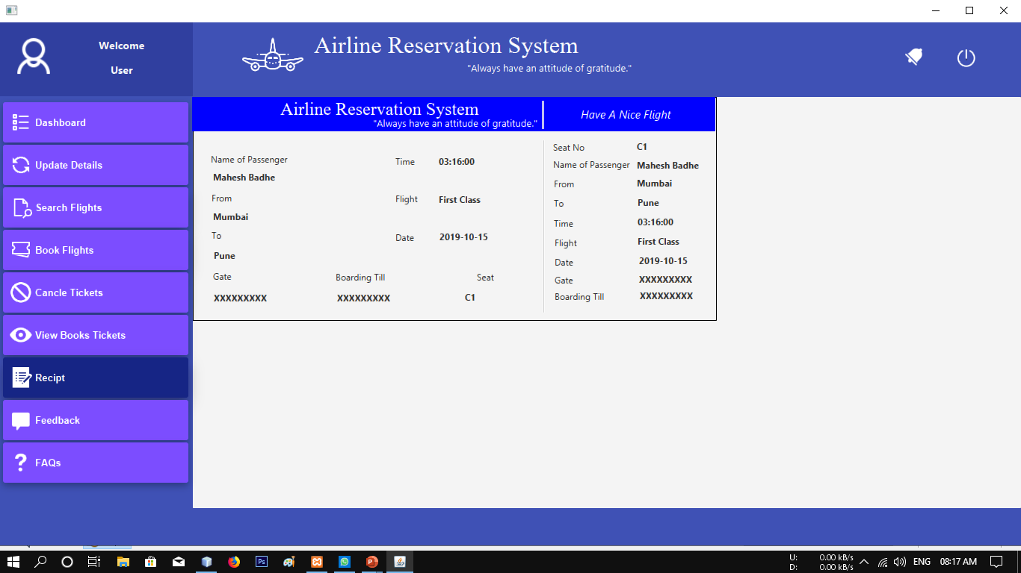
Final Receipt

Slide 31
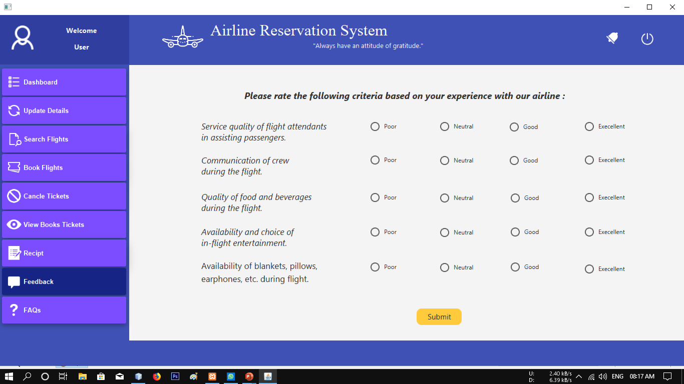
Customer Feedback to improve services

Slide 32
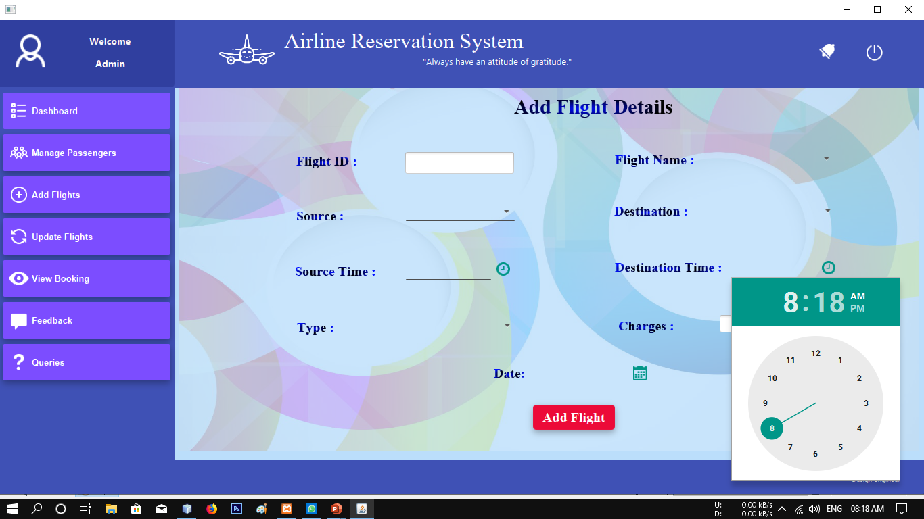
Scheduling Flights for Passengers

Slide 33
Advantages :
Easy to book tickets.
Saves time and money.
Provides every information about flight.
24/7 customer support through chat and calls.
Send automated tickets to the customer by mail.
Easy Refund Policies.
Available for both Domestic and International Airlines

Slide 34
Conclusion :
The Airline reservation system a java project is not an exception. With working employees traveling 24/7 this software speed up your reservation process and makes it convenient for the customers to book flights whenever and wherever!
It reduces the scope of manual error and conveniently maintains any modifications, cancellations in the reservations.
It not only provides flight details but also but also creates a platform to book tickets, cancels or modifies ticket timings or dates and even informs about the number of people on board!

Slide 35
References :
https://brainly.in/question/3104842#readmore
https://www.academia.edu/6521426/REQUIREMENTS_Analysis_Documentation_for_Air_ticket_reservation_system_ATRS_Team_Composition_Project_Title_Air_ticket_reservation_system_Prepared_By_S_No
https://www.slideshare.net/ash21j/airline-reservation-27531607
https://www.coursehero.com/file/16389580/Abstract-for-Airline-Reservation-System/
https://www.oracle.com/technetwork/java/javase/downloads/jdk-netbeans-jsp-3413139-esa.html
https://netbeans.org/community/releases/81/relnotes.html

